Slide 1
Multimedia Systems Lecture – 35,36
By
Dr. Priyambada Subudhi
Assistant Professor
IIIT Sri City

Slide 2
Multimedia Communications and Networking
Computer communication networks are essential to the modern computing environment.
Multimedia communications and networking share all major issues and technologies of computer communication network.
The evolution of the Internet, particularly in the past two decades, has been largely driven by the ever-growing demands from numerous conventional and new generation multimedia applications.

Slide 3
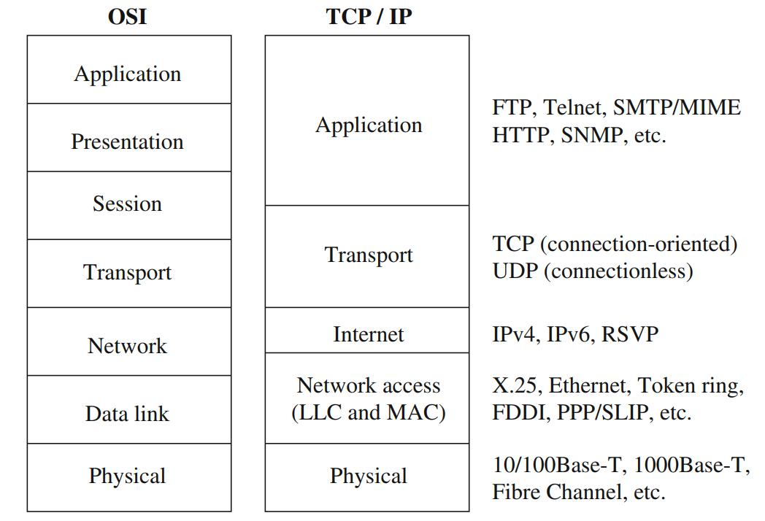
Protocol Layers of Computer Communication Networks

Slide 4
Quality-of-Service for Multimedia Communications
Fundamentally, multimedia network communication and traditional computer network communication are similar, since they both deal with data communications.
However, challenges in multimedia network communications arise due to a series of distinct characteristics of audio/video data:

Slide 5
Voluminous and Continuous
They demand high data rates, and often have a lower bound to ensure continuous playback.
A user expects to start playing back audio/video objects before they are fully downloaded. Commonly referred to as continuous media or streaming media.
Real-Time and Interactive
They demand low startup delay and synchronization between audio and video for “lip sync”.
Interactive applications such as video conferencing and multi-party online gaming require two-way traffic, both of the same high demands.
Rate fluctuation
The multimedia data rates fluctuate drastically and sometimes bursty.
In VoD or VoIP , no traffic most of the time but burst to high volume.
In a variable bit rate (VBR) video, the average rate and the peak rate can differ significantly, depending on the scene complexity

Slide 6
Quality of Service
Quality of Service, also termed QoS, indicates how well a network performs with multimedia applications, regardless of whether the network is conforming to the required traffic for the application (the capability of a network to provide a level of service to deliver network packets from a sender to a receiver).
QoS for multimedia data transmission depends on many parameters.
Bandwidth:
A measure of transmission speed over digital links or networks, often in kilobits per second (kbps) or megabits per second (Mbps).
The data rate of a multimedia stream can vary dramatically, and both the average and the peak rates should be considered when planning for bandwidth for transmission.
Latency (maximum frame/packet delay)
The maximum time needed from transmission to reception, often measured in milliseconds (msec, or ms).

Slide 7
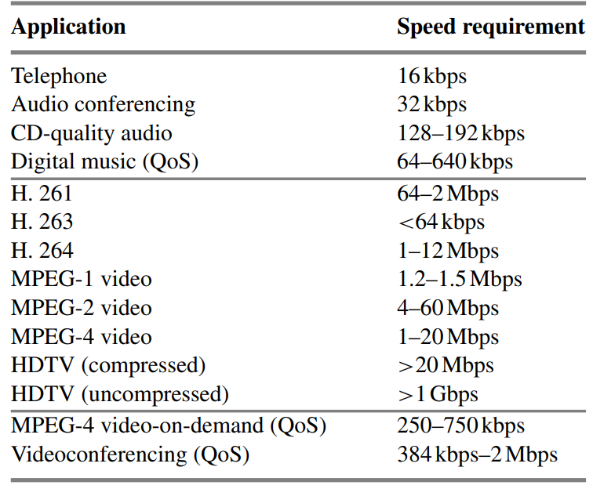
Requirement on network bandwidth/bitrate

Slide 8
Packet loss or error rate
The packets can get lost due to network congestion or garbled during transmission over the physical links. They may also be delivered late or in the wrong order.
Error rate measures the total number of bits (packets) that were corrupted or incorrectly received compared with the total number of transmitted bits (packets).
For real-time multimedia, retransmission is often undesirable, and therefore alternative solutions like forward error correction (FEC), interleaving, or error-resilient coding are to be used.
Jitter (or delay jitter):
A measure of smoothness (along time axis) of the audio/video playback. Technically, jitter is related to the variance of frame/packet delays.
A large buffer (jitter buffer) can be used to hold enough frames to allow the frame with the longest delay to arrive, so as to reduce playback jitter. However, this increases the latency and may not be desirable in real-time and interactive applications.
Sync skew:
A measure of multimedia data synchronization, often measured in milliseconds (msec). For a good lip synchronization, the limit of sync skew is ±80 msec between audio and video. In general, ±200 msec is still acceptable.

Slide 9
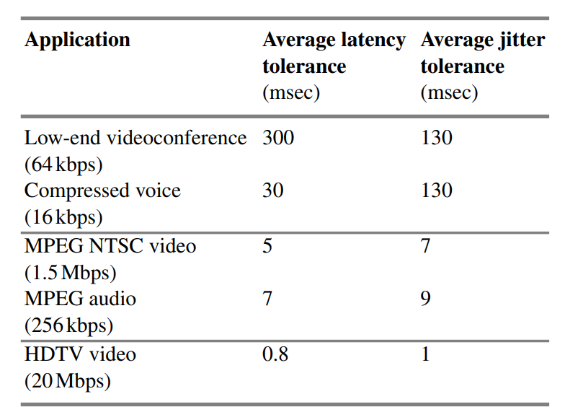
Tolerance of latency and jitter in digital audio and video

Slide 10
Different applications have varied QoS requirements. Some sample requirements include the following:
Streaming media might impose QoS requirements on a guaranteed bandwidth and low latency but a more tolerable jitter.
Videoconferencing or IP telephony, which are real-time applications, might require stricter limits on jitter and maximum delay, but could tolerate errors.
Online games where multiple players play together across a network need more real-time QoS constraints with bounded latency and jitter.
A remote surgery, which is a health-critical application, might need a guaranteed level of connection availability compared with other requirements.

Slide 11
A better categorization of QoS levels are best-effort service, differentiated service, and guaranteed service.
best-effort service (lack of QoS): The best-effort service provides basic connectivity with no guarantees or priorities to packets in transit across the network.
differentiated service (soft QoS): Packets are marked with a priority, which is used to give partial preference while routing of packets at intermediary nodes.
guaranteed service (hard QoS): In this service, packet delivery is guaranteed at any cost. There is an absolute reservation of network resources that are dedicated to packet delivery.

Slide 12
Multimedia over LAN and WAN
Networks set up for communication can be divided broadly into two categories based mostly on distribution over a geographic area: local area networks (LANs) and wide area networks (WANs).
LAN
Local area network (LAN) is a term used for a network when it is restricted to a small geographical area and has a small number of stations.
The one common feature that defines a LAN is a single, shared medium to transport data between computers.
Hence, protocols to access, use, and relinquish control of the medium are of primary importance in any LAN.
These protocols typically reside in the Medium Access Control (MAC) sublayer in the OSI-specified Data Link layer.
The MAC layer connects a node to the physical medium and governs access to it. A variety of protocols exist, which are incorporated into standards that control access to the physical medium and can be divided into the following subcategories: round-robin (token ring), reservation (Time division multiplexing), and contention (CSMA/CD, CSMA/CA).

Slide 13
WAN
Wide area networks cover wider geographical areas and connect various LANs together. The most well-known WAN is the Internet
The protocols used to establish connections on such nonshared mediums normally employ switching technologies.
Circuit Switching:
An end-to-end circuit is established in a dedicated manner between the sender and the receiver nodes for the duration of the connection and also for a specified bandwidth. E.g. Public Switched Telephone Network (PSTN).
The PSTN was initially put into place for voice communications, but has also been used for data transmission and forms the basis of all modem-based communications, Integrated Services Digital Network (ISDN), and Asymmetric Digital Subscriber Line (ADSL).
The data rates here are very low and are only sufficient if the demanded data rate by a user is constant—for example, in data-only transmission or constant bit rate multimedia video and audio traffic. Not suitable for real time multimedia communication.

Slide 14
Packet Switching:
Packet switching is more efficient for varying data rates and real-time communications because higher data rates can be accommodated.
Prior to transmission, the sender node breaks the data into smaller sections encapsulated into packets.
Packet-switching technology normally follows one of two approaches: connectionless and connection oriented.
Packet-switching networks provide higher data rates compared with circuit-switching networks; however, their performance starts to deteriorate when the network gets congested.
Examples of protocols that are implemented for packet switching are X.25, which is the most common, and IP. These normally reside in the Network layer and also perform extensive error checking to ensure no data corruption occurred during transit.

Slide 15
Frame Relay:
Frame relay is another simple connection-oriented setup that provides capabilities of both switched virtual connections (SVCs) as well as permanent virtual connections (PVCs).
Frame relay includes all the operations provided by X.25, except that there is reduced error checking, which mean no acknowledgements, flow control, or error control because these mediums have minimal loss and corruption.
However, the error detection, correction, and flow control can be optionally performed by a higher layer such as the Transport layer. Frame relay is, thus, a simplified X.25 protocol with minimal services.

Slide 16
Asynchronous Transfer Mode:
In case of synchronous transmission, the two nodes, thus, use resources and allocate bandwidth for the entire duration, even when they are not transmitting any data, and even if the connection is set up as a multiplexed connection.
Asynchronous Transfer Mode technology solves this by first statistically multiplexing where packets of all traffic routes are merged together into a single queue and transmitted on a first-come, first-served basis, rather than allocating a time slot for that route when no data is flowing. This maximizes the throughput compared with synchronous mode transmissions.
ATM networks, thus, make it feasible to support high-bandwidth multimedia requirements.
ATM adopts only small, fixed-length packets, called cells, which provide the additional benefit of reducing latency in ATM networks
ATM networks can provide high speed and low delay. Hence, can support up to 2.5 Gbps.

Slide 17
Multimedia Communication Protocols
General Protocols: This subsection first discusses general protocols used in communication that do not necessarily take care of requirements imposed by real-time media.
Internet Protocol (IP):
The Internet Protocol (IP) is a Network layer protocol that represents the main methodology of communication over the Internet.
To provide fragmentation of large data into packets and its consequent reassembly.
To provide a connectionless method of data packet delivery.
The IP addressing mechanism is indispensable to how routing occurs in this protocol.
Because of the connectionless nature of the forwarding, packets can arrive via different routes and, consequently, out of order.

Slide 18
Transmission Control Protocol (TCP):
It is a connection-oriented transport layer protocol, which provides reliable data transfer.
TCP requires a connection to be established prior to sending data, and the connection must be terminated upon completion of transmission. To establish a connection, TCP uses a three-step agreement to open a TCP connection from a client to a server, the server acknowledges, and, finally, the client also acknowledges.
Every packet has both the source and destination addresses.
In-order packet reception
Error-free data transfer and Discarding duplicate packets
Although TCP ensures reliable transmission, the overhead of retransmission is normally a hindrance to maintaining real-time synchronization of multimedia data.

Slide 19
User Datagram Protocol (UDP)
The User Datagram Protocol (also termed as the Universal Datagram Protocol) is a connectionless protocol that sends each packet during a session along different routes.
UDP does not provide the reliability and in-order data transmission as TCP does because data packets might arrive out of order or be dropped by the network and no acknowledgements are sent by the receiver.
However, as a result, UDP is much faster compared with TCP and efficient for the transmission of time-sensitive data, such as in the case of synchronized multimedia data.

Slide 20
TCP/IP Family:
TCP itself is a reliable connection-oriented protocol to transfer data on a network; however, to deliver data on the connectionless Internet, it has to ride on IP and provide reliability, which includes in-order delivery and errorfree delivery, with the IP protocol
Thus, this family of protocols has the commonality of using IP as a Network layer to communicate data while providing support from the higher layers. The TCP/IP families of protocols include general data transfer protocols, such as FTP, HTTP, IMAP, SNMP, SMTP, TELNET, and so on.

Slide 21
Media-Related Protocols
Apart from the general protocol requirements such as those imposed by UDP or TCP, you also have media related requirements imposed by needs such as real time delivery, resource reservation requirements for guaranteeing a certain QoS level, identifying the media type that is being communicated and so on.
Hypertext Transfer Protocol (HTTP):
The Hypertext Transfer Protocol is an application layer protocol. It has been in use by the WWW.
HTTP works in a request-response manner between a client and a server. The originating client, typically a Web browser running on a computer, cell phone, PDA, or other end terminal, requests a document residing at a server location.
The destination server, typically called a Web server, responds by locating the document and sending the information back to the client. The information might be individual files of any kind or a collection of text, images, and other media organized in the form of an HTML document.

Slide 22
Real-Time Transport Protocol (RTP) with RTCP
The original IP protocols used on the Internet provided delivery of data packets on a “best-effort” basis. Although this might suffice for non-real-time applications such as e-mail and FTP, it certainly is not suited to real-time multimedia applications.
The RealTime Transport Protocol (RTP) along with a monitoring Real-Time Transport Control Protocol (RTCP) were designed to solve the real-time needs for multimedia traffic, such as video and audio streams in applications, video-on-demand, videoconferencing, and other live streaming media.
RTP runs on top of UDP, which provides efficient delivery over connectionless networks. It is preferably run over UDP rather than TCP because TCP’s reliability achieved by in-order delivery of packets does not address the real-time needs of multimedia traffic if packets are lost or held up along the route.
RTP has its own time stamping on each packet and sequencing mechanisms to help the receiver synchronize and render the information in sequence.

Slide 23
Real-Time Streaming Protocol (RTSP)
It was developed by the Internet Engineering Task Force (IETF) in 1998 and is useful in streaming media, as opposed to downloading the entire media content.
RTSP is designed for streaming communication between a client and a stored media server and achieves real-time communication by issuing simple commands like play, pause, stop, and so on and, therefore, allows time-based access to files on a server.
RTSP normally rides on top of RTP as the transport protocol for actual audio/video data. RTSP requests are sent over HTTP

Slide 24
Resource Reservation Setup Protocol (RSVP)
The Resource Reservation Setup Protocol is a setup protocol where a receiver node reserves network resources during a communication session so as to efficiently monitor and guarantee the desired QoS for unicast and multicast multimedia communication over an integrated services Internet.
RSVP works by applying two messages—a Path message and a Resv message.
A Path message is initiated by the sender to the receiver(s) and contains information of the path and nodes along the path to the receiver.
This is followed by one or more Resv messages from the receivers to reserve the intermediary node resources
In itself, RSVP is not a routing protocol, but works with the routing protocols to transmit data along allocated resources, which might be routers by themselves.

Slide 25
Session Initiation Protocol (SIP)
The Session Initiation Protocol is an Application-layer control protocol that has been set up to establish, modify, and terminate sessions in Internet telephony.
Although designed for Voice over IP applications, it is not limited to it, and is also used for multimedia-related communications, such as videoconferences, multimedia distribution, and so forth.
SIP transparently supports name mapping and redirection, which increases personal mobility, so users can maintain an external visible identifier regardless of their network location.
SIP is a client/server protocol where the sender client node connects to another receiver client node in a multimedia application by initiating a request to a server(s).
There are three types of servers—proxy server, whose job is to forward a client’s call request, redirect server, whose job is to return the address of the next hop server, and location server, which finds the current location of the clients.

Slide 26
Session Description Protocol (SDP)
The Session Description Protocol describes a multimedia session that needs to be in session between a caller client and a callee client.
A caller client must include this information when inviting the callee client during the initiation of communication, such as in the SIP Invite command.
The description information includes the media stream types used in the session (audio, video, and so on) and its capabilities, destination address (unicast or multicast) for each stream, sending and receiving port numbers, stream type indicators, and other things necessary to communicate media information.

Slide 27
A Case Study: Internet Telephony or Voice over IP (VoIP)
With ever-increasing network bandwidth and the ever-improving quality of multimedia data compression, Internet telephony has become a reality.
The main advantages of Internet telephony over the plain old telephone services are
It provides great flexibility and extensibility in accommodating such new services as voicemail, video conversations, live text messages, and so on.
It uses packet switching, not circuit switching; hence, network usage is much more efficient.
With the technologies of multicast or multipoint communication, multiparty calls are not much more difficult than two-party calls.
With advanced multimedia data-compression techniques, various degrees of QoS can be supported and dynamically adjusted according to the network traffic.
Richer graphical user interfaces can be developed to show available features and services, monitor call status and progress, and so on.

Slide 28
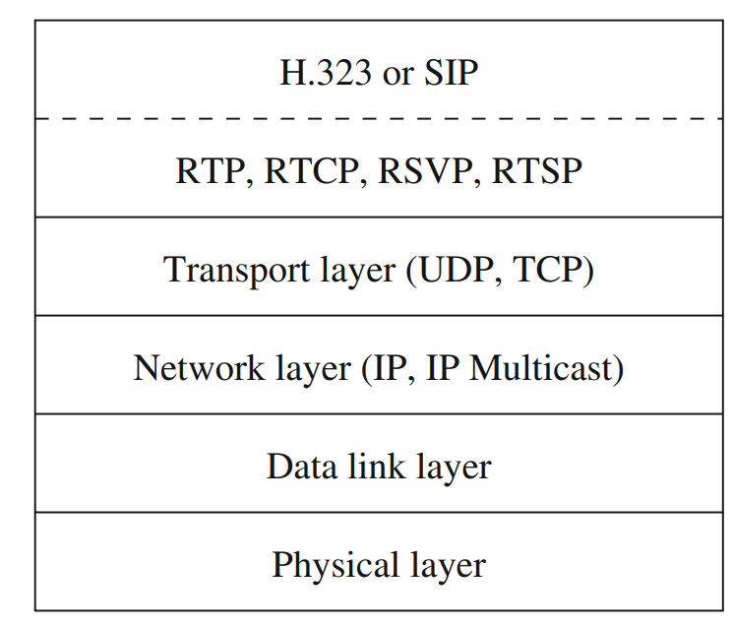
Network protocol structure for internet telephony
The transport of real-time audio (and video) in Internet telephony is supported by RTP (with its control protocol, RTCP).
Streaming media is handled by RTSP and Internet resource reservation, if available, is taken care of by RSVP.

